Slide 2
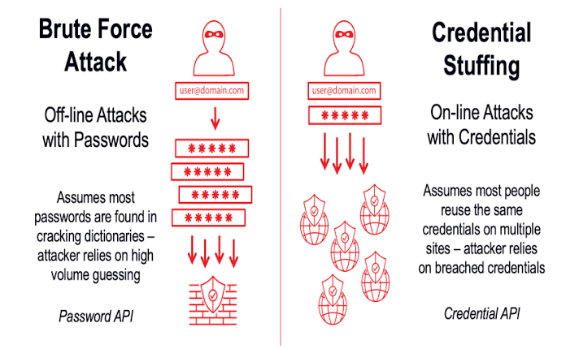
Initialize Hostname,
Username file,
Password file
Data calling
Start
Matching
Are brute force conditions met?
No
*****
Yes
Print credentials
End

